Slide 1
KPBSD Assembly Update
Penny Vadla, KPBSD School Board President
Sean Dusek, KPBSD Superintendent
December 5, 2017

Slide 2
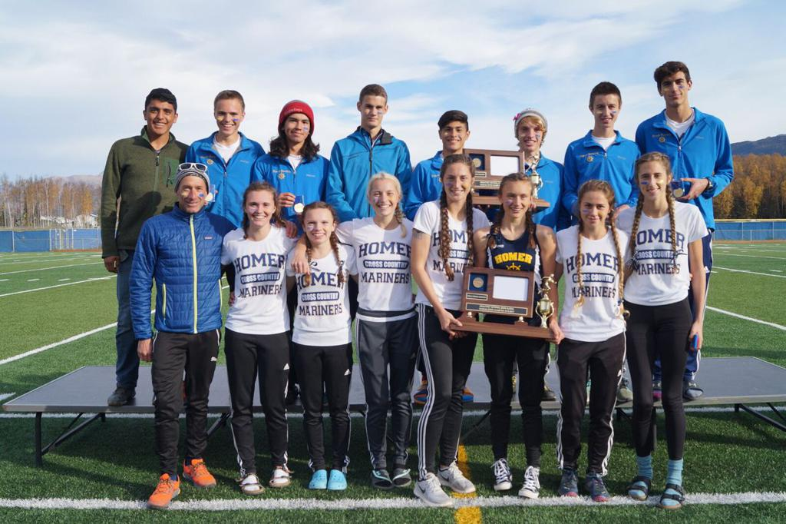
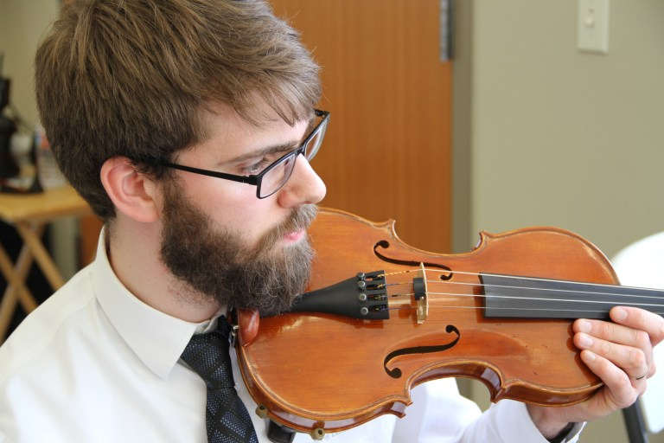
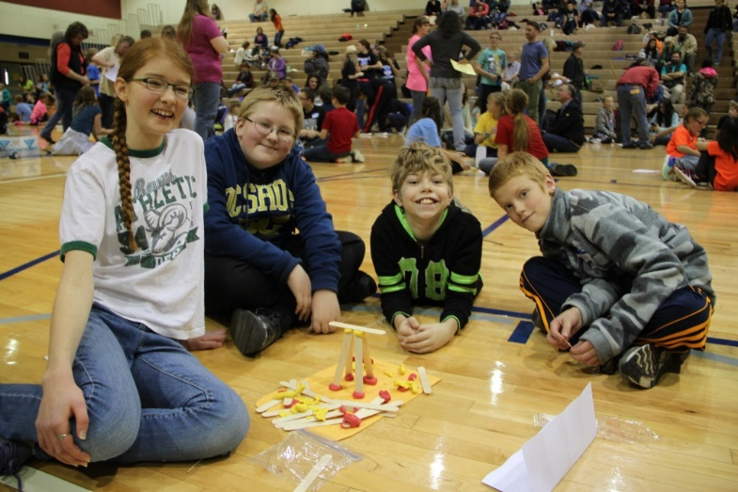
Tonight’s Update
School Board
Students
Budget
Thank you!

Slide 3
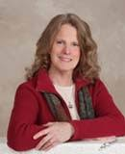
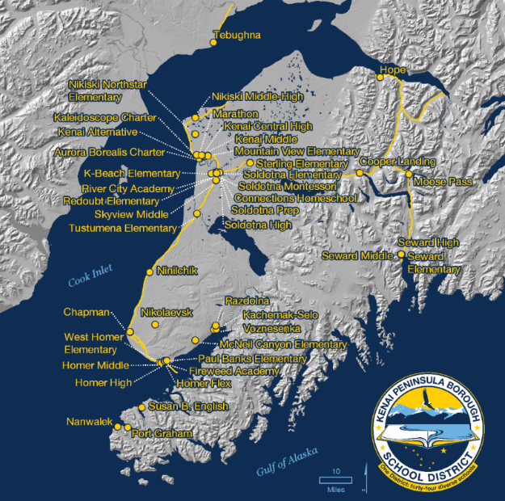
Introductions
Penny Vadla – KPBSD School Board President
Former KPBSD Teacher
KPBSD School Board member since 2008
AASB Board of Directors since 2016

Slide 4
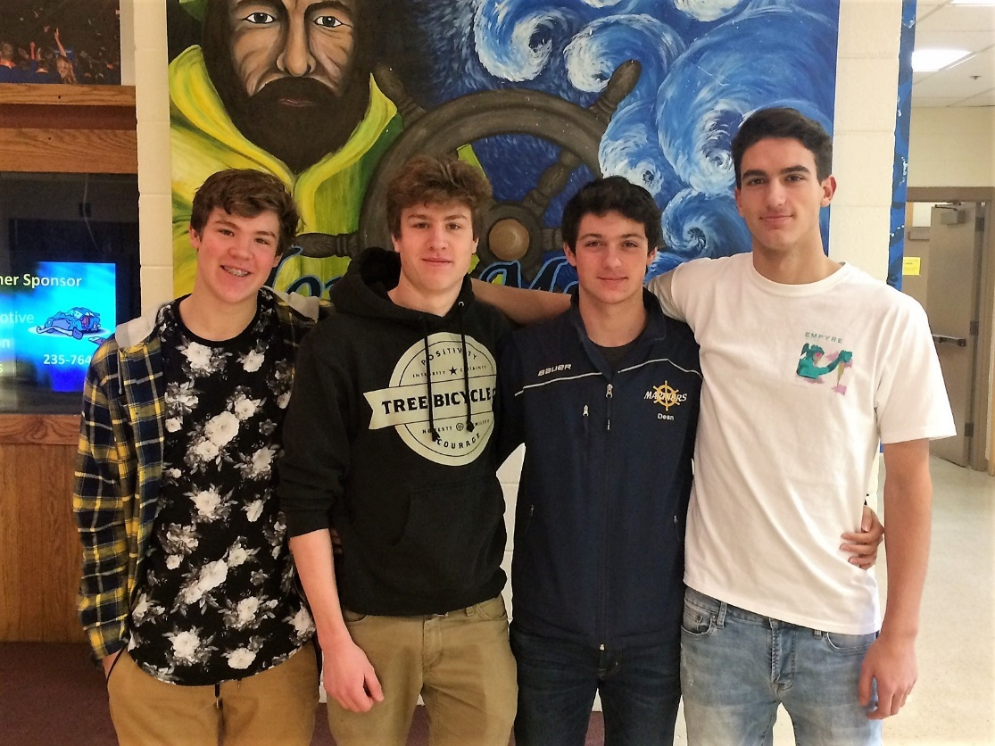
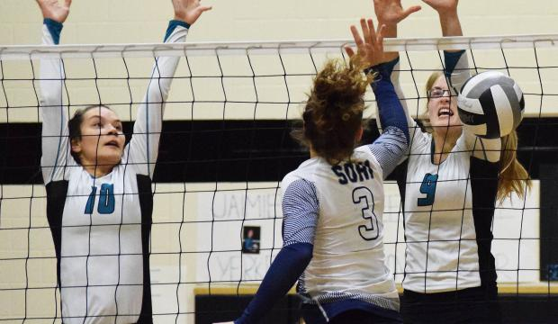
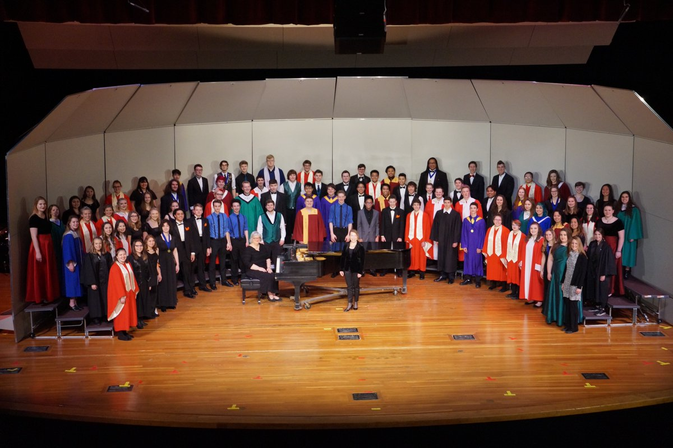
Student Update
Achievement
Activities
Learning

Slide 5
Results and Enrollment
Graduation Rate
Increased over the past several years – up to 84%
Native Education grad rate
Increased over last 3 years from 80% to 91%
Overall enrollment vs. special education enrollment
Since 1998 decrease by 1600 students overall
Special Education has increased by 322 students
Intensive Needs Students has increased by 135 students
Staff
Overall peak in 2014 of 1252 FTE
Currently (2018) at 1187 FTE

Slide 6
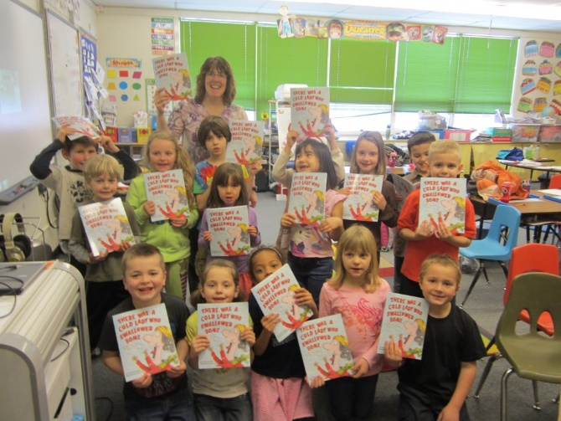
Innovation
Optimize the pace of learning for all students
Improve instructional approach tailored to individual student needs
Rigor, Relevance, Responsiveness
Strong, Positive Relationships are the foundation of our work

Slide 7
Budget
Process Update
December 4: FY18 wrap up
December 5: FY19
Borough work: Joint work session on December 5
January 15: Preliminary FY19 Budget
February to March: Multiple opportunities for input
April 2: FY19 budget approved by School Board

Slide 8
Budget
Clarity
Pupil Teacher Ratio was NOT adjusted for FY18
Certified Staff reductions were function of declining enrollment in FY17 and FY18
Since FY15 reductions of over $7 million
10 District Office positions
Curriculum, Supplies, Travel
Student Nutrition Services
Certified staff adjustments
Custodians for FY18

Slide 9
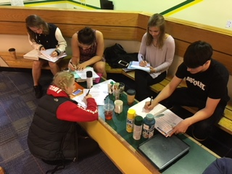
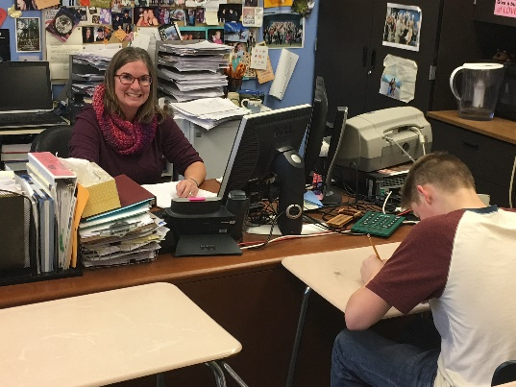
Thank you!
Thank you for your commitment to our KPBSD students and staff

