Slide 1
Presentation To Borough Assembly October 23, 2012
Financial Update of The Kenai Peninsula Borough School District

Slide 2
Today’s Meeting
Purpose of this meeting
Provide the Assembly with a review of district’s finances prior to the district beginning its FY14 budget
Plan
KPBSD Students-performance and enrollment
Financial Background-recent financial history
Current Financial Picture
Future Financial Picture

Slide 3
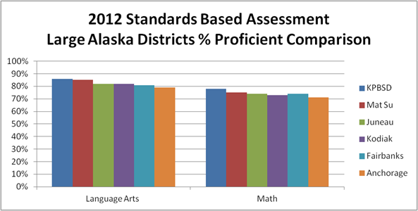
KPBSD Students Continue To Do Well on State Standardized Tests

Slide 4
KPBSD Graduation Rate Increases

Slide 5
Comparing FY12 Graduation Rates

Slide 6
Enrollment is still slowly declining
235 preschool students

Slide 7
FY13 Enrollment by grade

Slide 8
State Revenue and TRS/PERS On-behalf Payments

Slide 9
Review of Revenue for Recent KPBSD Budgets

Slide 10
KPBSD’s Current Financial Picture-Using Fund Balance to keep us whole
State
$99,699,673
Borough
$43,000,000
FY13 Budgeted General Fund Expenditures
$146,637,793
Federal and other
$2,176,000
Fund Balance
$2,762,120

Slide 11
KPBSD’s Fund Balance Totals FY02-FY13

Slide 12
Variables that Affect Fund Balance
State of Alaska Basic Need Components |  |  |  |  | FY08 | FY09 | FY10 | FY11 | FY12 | FY13 | FY14
 |  |  |  |  | Actual | Actual | Actual | Actual | 1/11/12 DOEED | Estimate
 | Enrollment |  |  |  | 9,249.70 | 9,255.77 | 9,144.67 | 9,025.06 | 8,969.57 | 8,871.00
 | District Cost Factors |  |  |  | 1.004 | 1.088 | 1.109 | 1.13 | 1.151 | 1.171 | 1.171
 | Intensive Services Factor |  |  |  | 5 | 9 | 11 | 13 | 13 | 13 | 13
 | Intensive Needs student Counts |  |  |  | 90 | 80 | 90 | 122 | 126 | 128
 | Base Student Allocation Value(BSA) |  |  |  | $ 5,380 | $ 5,480 | $ 5,580 | $ 5,680 | $5,680 | $5,680
 | One-Time Legislative Funding |  |  |  |  |  |  |  | $1,404,575 | $1,752,986
Federal ARRA Stimulus Funding
 | February 2009 to September 2011 |  |  |  |  | $10,121,811 |  |  |  | $ 0

Slide 13
FY13 Fund Balance Unknown
Potential Increase in Use of Fund Balance
Impact of settlement with two bargaining units. Approved budget includes our current offer.

Slide 15
Local School Funds Sales Tax and Property Tax- Growing Divide

Slide 16
Amount of Property Tax Used for School Funding is Decreasing
Fiscal Year | Mill Equivalent for schools | Amount of tax paid for schools on $200,000 Property | Amount of tax paid for schools on $400,000 Property
2010 | 2.758 | 551 | 1103
2011 | 2.317 | 420 | 927
2012 (estimated) | 2.1 | 463 | 840
2013 (projected) | 1.9 | 380 | 760
Amount of tax used for schools

Slide 17
Financial Considerations
Final District Cost Factor for KPBSD is set at 1.171
Last Increase to the Base Student Allocation was 2010
One time funding in 2011 and 2012 cannot be counted on for inclusion in following year’s budget
Change in required minimum contribution to 2.65 mills increases amount of state money to district and reduces maximum local contribution
Year 2 of 5 for CTE monies from state (increase of 7.1 certified FTE and 1.5 support FTE)
Unknown of negotiations with teachers and support staff

Slide 18
FY14 Budget
Keeping our level of service for our students as is, will require an increase in revenue or a bigger use of fund balance
81% of FY13 budget is for personnel
Request that the Borough help the District share our fiscal reality with our state legislators and public.
Request that the Borough consider the district’s proposal for how to calculate the amount of local contribution
Budget Development Committee Meeting on November 8, 9-3:30

Slide 19
Questions and Discussion

