Slide 1
Federal Programs Title I
Click into Slide Show mode to hear the audio.

Slide 2
Title I
KPBSD receives Title 1 funds to ensure that all children have a fair, equal, and significant opportunity to obtain a high-quality education.

Slide 3
2016-17 Federal Programs Budget
Title I | K-2 reading support | $933,635 | $1,944,336
 | Pre-kindergarten | $991,843
 | Parent Involvement | $18,857
Title IC | $243,867
Title IIA | $793,929
Title IIIA | $20,141
Title ID | $10,753
Title VI | $472,897
McKinney Vento | $15,000

Slide 4
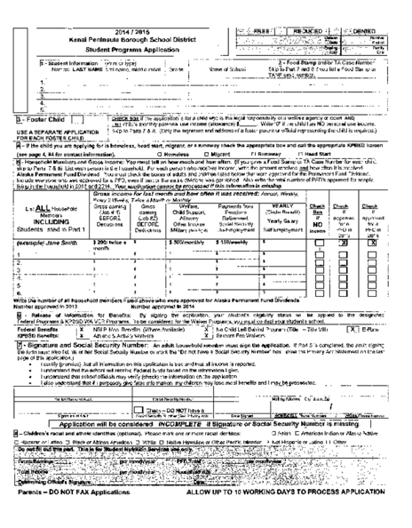

Slide 6
Which schools receive Title I services?
Chapman School
Redoubt Elementary
Fireweed
Seward Elementary
Kachemak Selo
Soldotna Elementary
Mountain View Elementary
Sterling Elementary
Nikiski North Star Elementary
Susan B. Anthony
Nikolaevsk
Tebughna
Ninilchik School
Tustumena Elementary
Paul Banks Elementary
Voznesenka
Razdolna
Homer Flex

Slide 7
Title 1 funds provide K-2 reading support or prekindergarten
K-2 reading
support only
Fireweed
Kachemak Selo
Nikolaesk
Razdolna
Susan B. English
Tebughna
K-2 reading support and Prekindergarten
Ninilchik
Mountain View Elem
Tustumena
Prekindergarten
Chapman
Nikiski North Star Elem
Redoubt Elem
Sterling Elem
Paul Banks Elementary
Seward Elementary
Soldotna Elem
Voznesenka

Slide 8
Why don’t all schools receive Title I services?
KPBSD uses Title I funds to provide preschool and
reading support to students in kindergarten, first and
second grade in those schools meeting the 35%
economically disadvantaged threshold as evidenced
by free and reduced lunch applications.

Slide 9
Title I Staffing
Reading intervention = 5 teachers
Mt. View
Tustumena
Kachemak Selo
Razdolna
PreK = 11 Teachers
Chapman
Ninilchik
Paul Banks
Sterling
Mt. View
Nikiski North Star
Voznesenka
Soldotna Elem
Tustumena
Redoubt
Seward Elem
Afterschool tutoring/support personnel
Tebughna
Nanwalek
Ninilchik
Susan B. English
Homer Flex
Fireweed
Nikolaevsk

Slide 10
Which students receive services at KPBSD Title I schools?
Step 1: AIMSweb identifies students performing below the 25th percentile
Step 2: Teams of teachers match student needs to Title 1 services
Step 3: Second assessment administered
Step 4: Parents notified of eligibility
Step 5: Services begin ☺
This process is done three times each school year – Fall, Winter & Spring.

Slide 11
1% of the Title 1 budget is devoted to parent involvement activities. Each school has an activity in the Fall and again in the Spring. Activities and purchases using parent involvement funds are determined based on student needs during Title 1 meetings.
Book Bags
Make and Take Activities
Reading nights
Kindergarten material

Slide 12
Title I Pre-kindergarten
Approximately 180 pre-kindergarten students enrolled for the 2016-17 school year
Eligibility determined by DIAL
Assessments administered in the Spring
Pre-kindergarten programs focus on:
creating a caring community of learners
teaching to enhance development & learning
planning curriculum to achieve important goals
assessing children’s development & learning
establishing reciprocal relationship with families

Slide 13
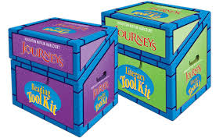
All programs use Sonday Systems, Sound Partners, or Houghton Miflin Intervention.
This research based
program provides support from
beginning reading to
end of second grade
Houghton Miflin Intervention kits
target, apply and practice key
Reading foundation skills in
the primary grades
Sound Partners
focuses on early
reading skills.

Slide 14
KPBSD Title I funds
provide services
to over 500 students.

Slide 15
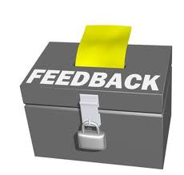
The link below will allow you to provide feedback on KPBSD Title I programs. Your comments, questions, and feedback is greatly appreciated!
https://www.surveymonkey.com/r/ZVZSJQZ

Slide 16
Federal Programs District Office Personnel
Tim Vlasak, Director
Assessment, Curriculum, Federal Programs & Small Schools
tvlasak@kpbd.org

