Slide 1
Federal Programs Title ID Delinquent and Neglected, McKinney Vento Students in Transition & Youth in Detention
Click into Slide Show mode to hear the audio.

Slide 2
McKinney Vento
McKinney Vento grant funds provide resources
for homeless youth so they experience
consistent, uninterrupted education.
Services are offered through the KPBSD
Students in Transition Program.

Slide 3
2016-17 Federal Programs Budget
Title I | K-2 reading support | $933,635 | $1,944,336
 | Pre-kindergarten | $991,843
 | Parent Involvement | $18,857
Title IC | $243,867
Title IIA | $793,929
Title IIIA | $20,141
Title ID | $10,753
Title VI | $472,897
McKinney Vento | $15,000

Slide 4
How does the law define “homeless”?
Children and youth who lack a fixed, regular, and adequate nighttime residence
Sharing housing of other persons due to loss of housing or economic hardship
Living in emergency shelters
Living in hotels, motels, or campgrounds
Living in a car, RV, or substandard housing
Unaccompanied Youth

Slide 5
Students in Transition Program Enrollment History

Slide 6
McKinney-Vento supports…
Immediate School Enrollment
Access to the free meal program
Transportation to/from school

Slide 7
Other assistance to students in transition
School supplies
Basic school clothing
Birth certificates
Emergency food
Hygiene products and services
Referrals to other community providers/programs
FAFSA verification for graduating seniors
Other services on a case-by-case basis

Slide 8
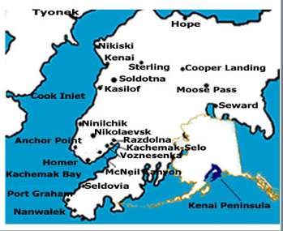
SIT staffing provided by Title I
One full-time Coordinator/Liaison (Central Peninsula area, Seward, and Tyonek)
One part-time Liaison (Homer area)

Slide 9
Title ID Neglected & Delinquent
Title ID funds provide academic activities
for students residing at Marathon School.

Slide 10
Youth in Detention
State funds to support academics of incarcerated youth at Marathon School
$69,143
Supports staffing

Slide 11
The link below will allow you to provide feedback on KPBSD McKinney Vento, Students in Transition & Title ID Delinquent and Neglected programs. Your comments, questions, and feedback is greatly appreciated!
https://www.surveymonkey.com/r/Z795M7Q

Slide 12
Federal Programs District Office Personnel
Tim Vlasak, Director
Assessment, Curriculum, Federal Programs & Small Schools
tvlasak@kpbd.org

