Slide 1
Federal Programs Title IIIA English Language Learners
Click into Slide Show mode to hear the audio.

Slide 2
Title IIIA English Learners
KPBSD receives Title IIIA funds to support
language instruction for Limited
English Proficient students.

Slide 3
2016-17 Federal Programs Budget
Title I | K-2 reading support | $933,635 | $1,944,336
 | Pre-kindergarten | $991,843
 | Parent Involvement | $18,857
Title IC | $243,867
Title IIA | $793,929
Title IIIA | $20,141
Title ID | $10,753
Title VI | $472,897
McKinney Vento | $15,000

Slide 4
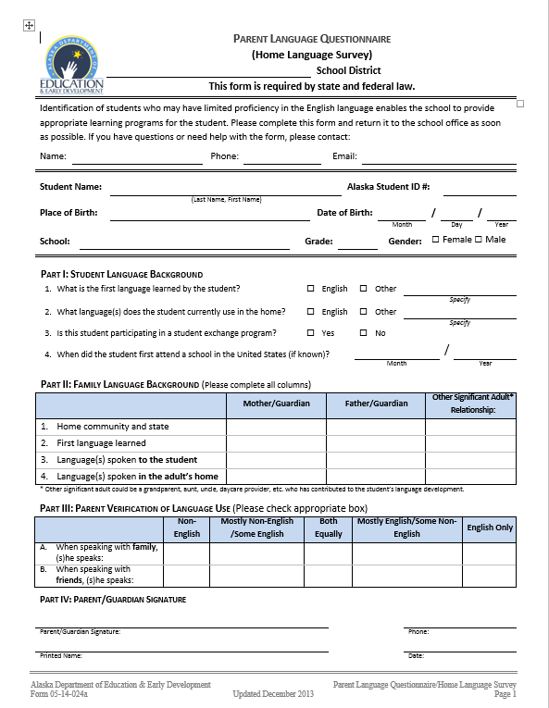

Slide 5
Limited English proficient students…
Between 3 and 21 years old
Enrolled in elementary or secondary school
An individual not born in the USA OR whose language is a language other than English OR who comes from a community where the primary language spoken is not English
Have difficulty in speaking, reading, writing or understanding English which is affecting academic achievement
****LEP students meet all the criteria above

Slide 7
2015-16 Demographics
336 ELL Students
37 Schools
24 Languages

Slide 8
WIDA English Language
Development (ELD) standards
Data reporting
Title IIIA funds support
professional development to
teachers and tutors of our
English Language learners.
Student identification
Assessment

Slide 9
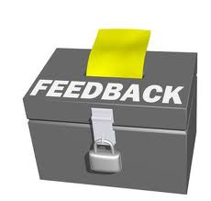
The link below will allow you to provide feedback on KPBSD Title I programs. Your comments, questions, and feedback is greatly appreciated!
https://www.surveymonkey.com/r/Z72JNM2

Slide 10
Federal Programs District Office Personnel
Tim Vlasak, Director
Assessment, Curriculum, Federal Programs & Small Schools
tvlasak@kpbd.org

