Slide 1
Federal Programs Title VI Indian Education
Click into Slide Show mode to hear the audio.

Slide 2
Title VI
Title VI funds support the unique educational and culturally related academic needs of American Indian and Alaska Native students so that they meet the challenging academic achievement standards all students are expected to meet.
Notes:
Tit

Slide 3
Title VI
A long standing goal has been the building and leveraging of partnerships with Native organizations to provide additional opportunities for students.
Thank you to all partner organizations.

Slide 4
2016-17 Federal Programs Budget
Title I | K-2 reading support | $933,635 | $1,944,336
 | Pre-kindergarten | $991,843
 | Parent Involvement | $18,857
Title IC | $243,867
Title IIA | $793,929
Title IIIA | $20,141
Title ID | $10,753
Title VI | $472,897
McKinney Vento | $15,000

Slide 6
What do Title VI funds support?
Targeted tutoring in KPBSD middle schools
Kenai Peninsula Native Youth Leadership program of which Project Grad has oversight
Culture and Language opportunities
Committee prioritized initiatives

Slide 8
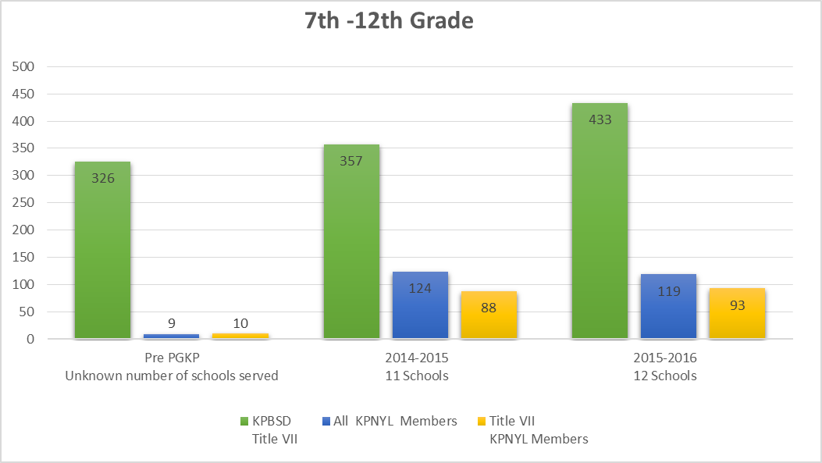
Kenai Peninsula Native Youth Leaders allow middle and high school students to learn and practice leadership skills through funded activities.

Slide 9
Last year, VI tutors regularly served over 100 students in these middle schools:
Nanwalek
Nikiski Middle
Ninilchik
Port Graham
Susan B English
Seward Middle
Soldotna Middle
Tebughna
18 students participated in Alaska Native Science and Engineering Program (ANSEP) Middle School Academy for 12 days in February
24 students participated in ANSEP’s 5 day summer workshops

Slide 10
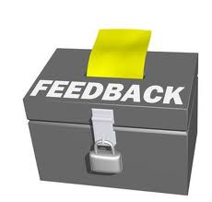
The link below will allow you to provide feedback on KPBSD Title I programs. Your comments, questions, and feedback is greatly appreciated!
https://www.surveymonkey.com/r/Z7WDK83

Slide 11
Federal Programs District Office Personnel
Tim Vlasak, Director
Assessment, Curriculum, Federal Programs & Small Schools
tvlasak@kpbd.org

